Slide 2
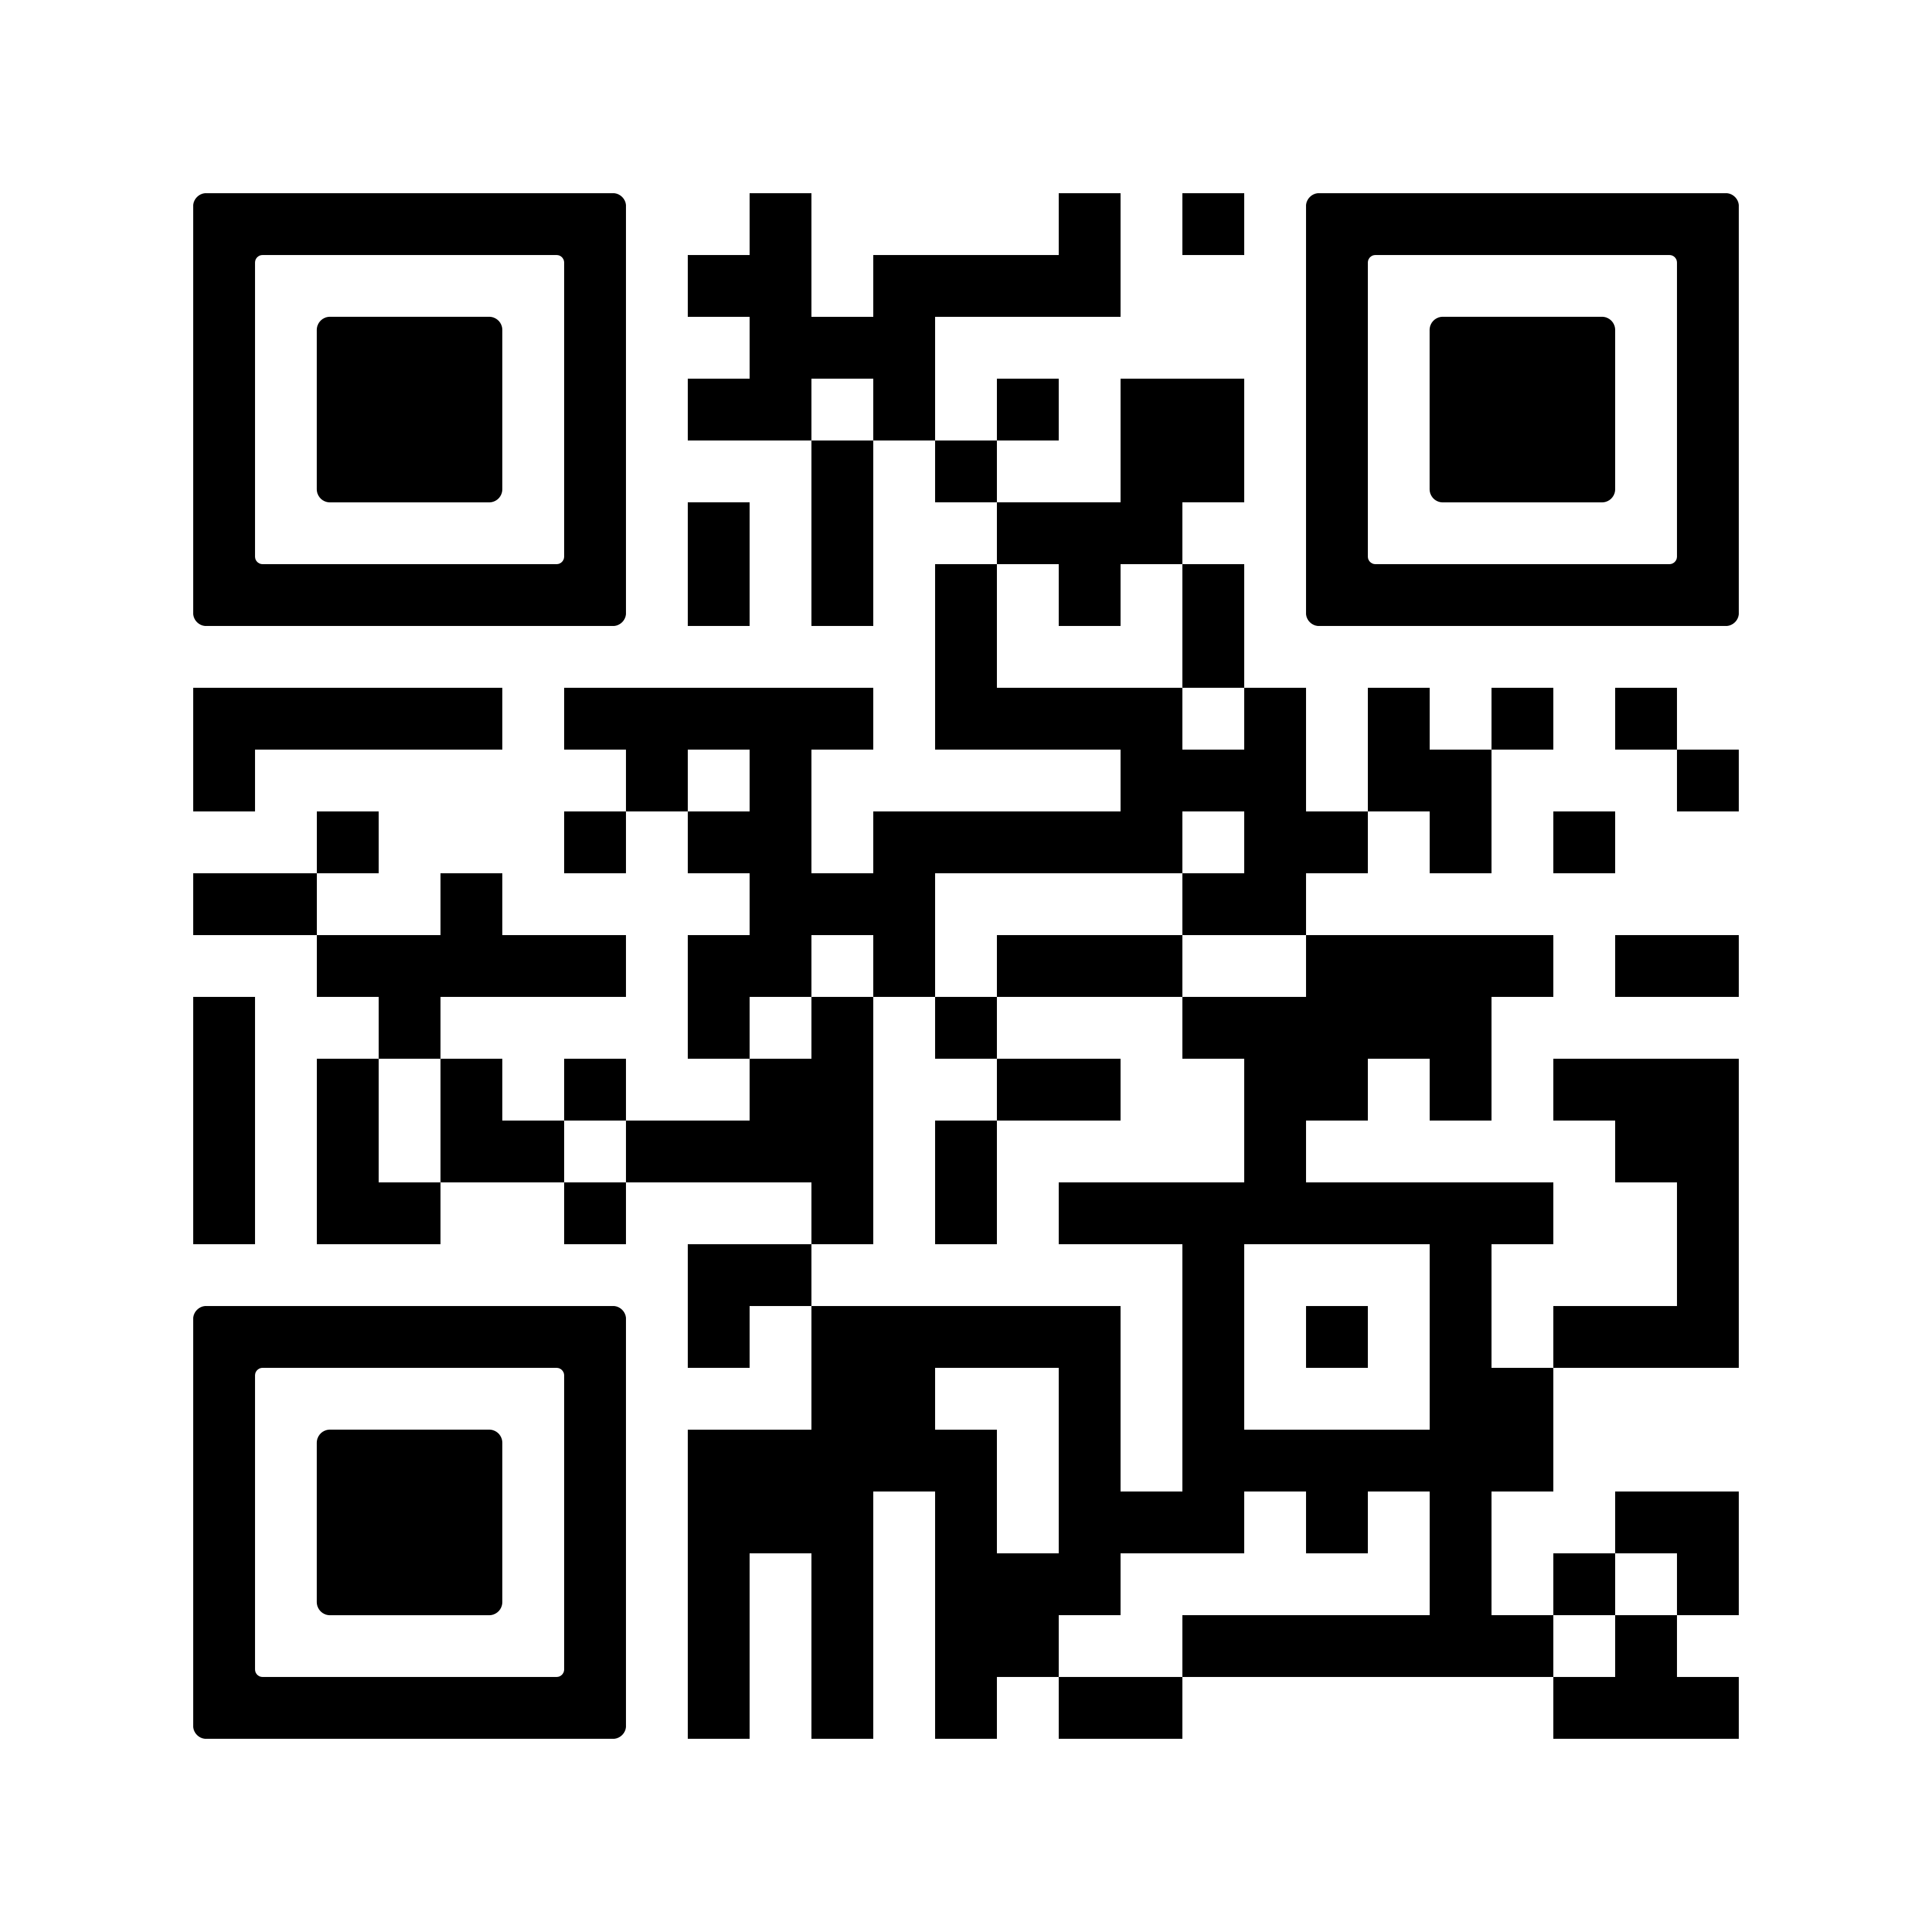
BLUE SUNDAY
APRIL 27, 2025
SUPPORT…
VOLUNTEER…
EDUCATE YOURSELF…
BE A HERO!
WANT TO BECOME A HERO?
FLY OVER TO OUR WEBSITE!

