Slide 1


Slide 2


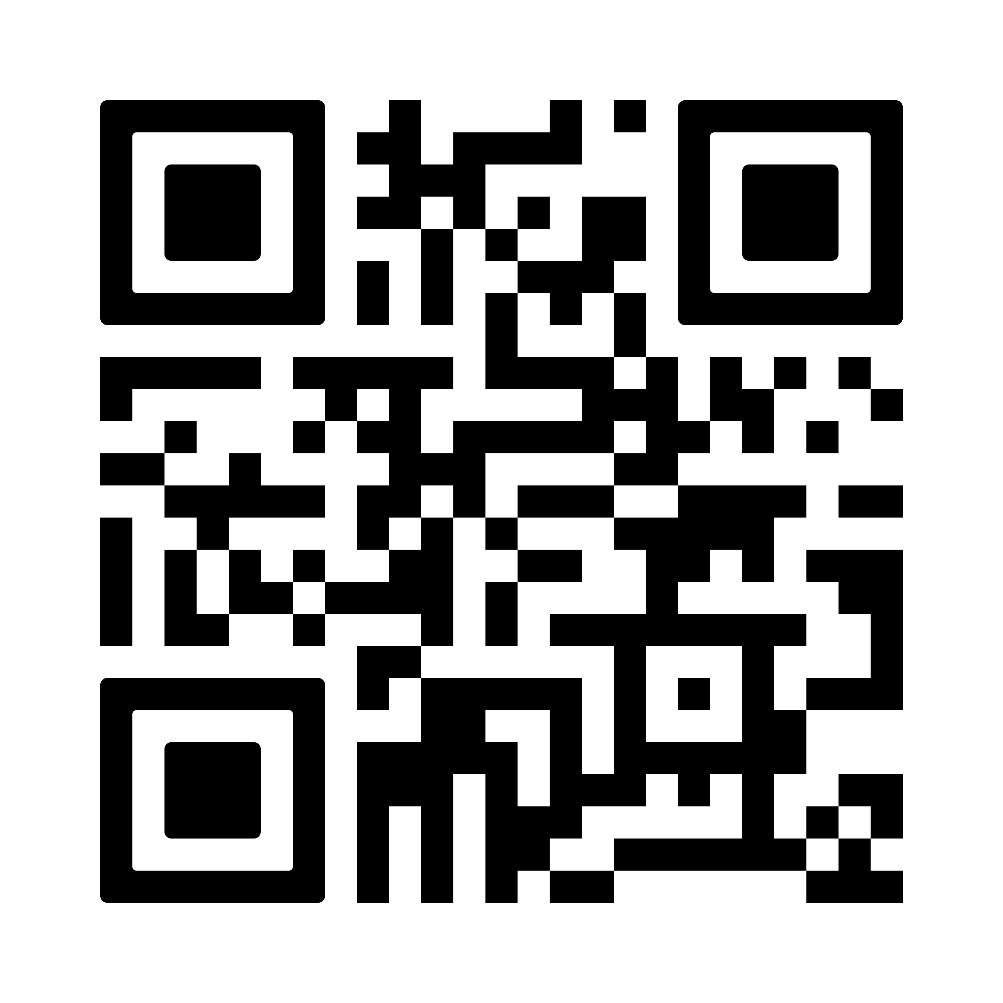
BLUE SUNDAY
APRIL 26, 2026
SUPPORT…
VOLUNTEER…
EDUCATE YOURSELF…
BE A HERO!
WANT TO BECOME A HERO?
FLY OVER TO OUR WEBSITE!

